Slide 1
Lecture 13
Classes and structures, pt.5
Konstantin Leladze
OOP in C++
DIHT MIPT 2021

Slide 2
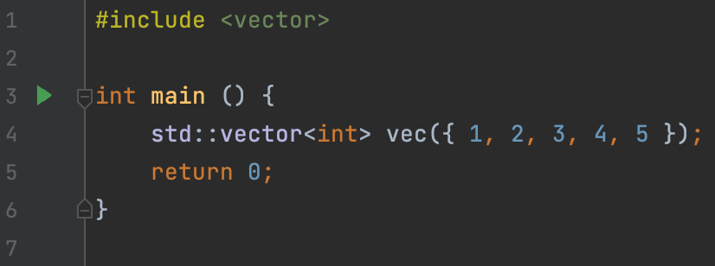
std::vector: constructor from initializer list
std::array is a dynamic (non-fixed), expandable array. Vector owns elements like any container, so we can say that it is using the RAII idiom.
To create a vector, you need:
To include <vector> header
To pass the type of the vector element in the vector in triangle brackets (as a template parameter)
To call constructor from std::initializer_list

Slide 3
std::vector: other methods, similar to std::array
Naturally, the vector supports both the copy constructor and the copy assignment operator. They work the same way as with std::array. Of course, the types of the vectors must match for copying to be possible!
The std::vector class has the operator[] overloaded in the same way as in the case of std::array. Similar to std::array, it has 2 versions: const and non-const.
Other methods that were present in std::array too
size() returns the amount of elements in the vector
front() is identical to the vec[0]
back() is identical to the vec[vec.size() - 1]
empty() returns true if array is empty, false otherwise
operator== compares two vectors

Slide 4
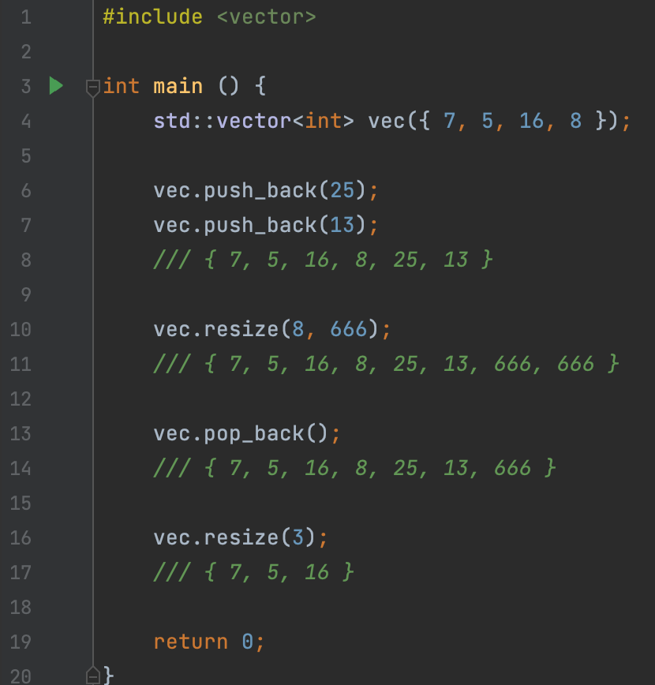
std::vector: methods, changing its size:
push_back() appends element to the end
pop_back() removes the last element of the vector
resize() resizes the vector, addining new elements if new size is greater than the old size. Elements in this case are initialized with value, provided in the second argument. Or, if the new size is less than the old size, removes a certain number of elements.

Slide 5
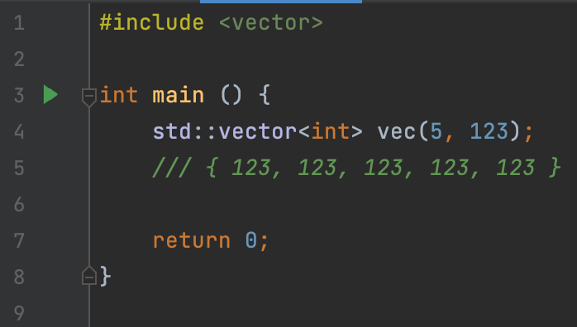
std::vector: constructor from size and value
Vector has a useful constructor that std::array lacks. It allows you to do many useful things, which we will analize in examples today.
This constructor takes 2 arguments, the same as the resize method: the size and the value that the vector elements will be initialized to.

Slide 6
std::array VS std::vector
std::array
non-expandable
size should be fixed and known at compilation stage
uses stack memory to allocate elements
std::vector
expandable
size can be dynamic and may change during the vector’s lifetime
uses dynamic (heap) memory to allocate elements
Conclusion: std::array should be used when the size of the array is known at compile time. In other cases, you should use the vector

Slide 7
std::string

Slide 8
range-based for loop

Slide 9
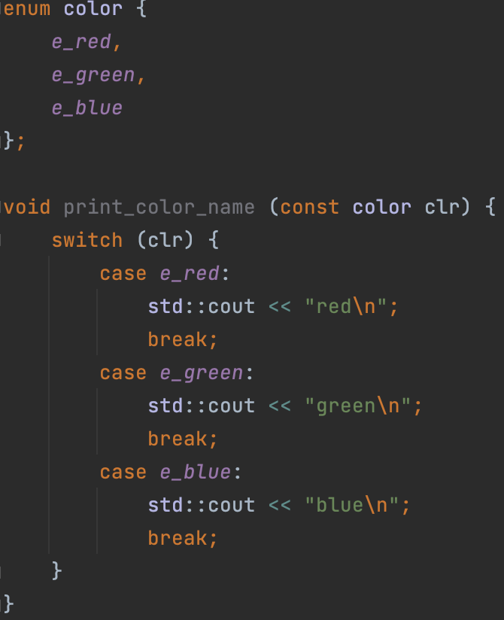
enums
An enumeration is a distinct type whose value is restricted to a range of values (see below for details), which may include several explicitly named constants ("enumerators"). The values of the constants are values of an integral type known as the underlying type of the enumeration.
Enum should be used as a label when you have several alternatives and need to specify which one you want to use.
Enum is very easy to use with switch / case

Slide 10
Practice
Problem 1 [Solution]
You are given the coordinates of a bishop on a chessboard. Print out the coordinates of each cell to which you can make a move.
Problem 2 [Solution] You are given two numbers n, m, and a matrix of size n by m. Transpose it and print it out.
Problem 3 [Solution]
You are given a string. You should check if it is a palindrome, or not.

Slide 11
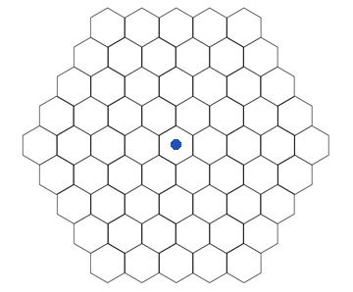
Practice
Problem 4 [Solution]
Write a hexagonal_grid_traveler, which represents the traveller on hexagonal grid.
Public enum direction (should be inside the class!), which should have six enumerators: e_up, e_up_right, e_down_right, e_down, e_down_left, e_up_left
Default constructor, copy constructor, copy assignment operator, destructor
Public non-const method move, which receives enumerator of the enum direction by a value and returns void. Moves the traveller in the provided direction.
Public const method (getter) get_coordinates, which should return current coordinates of the traveller in the field by a const reference;

Slide 12
Class bigint

Slide 13
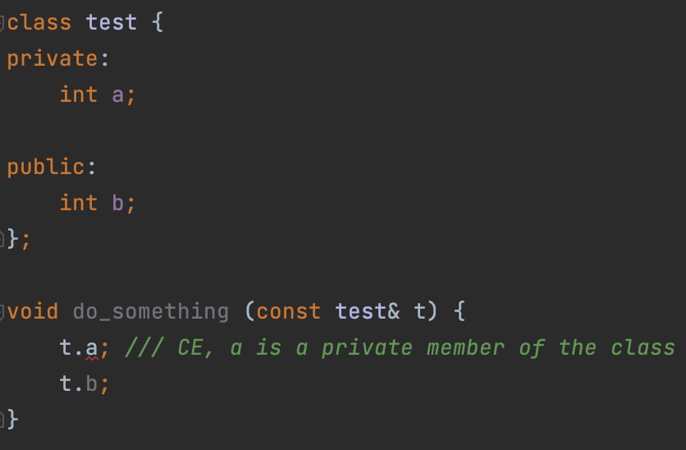
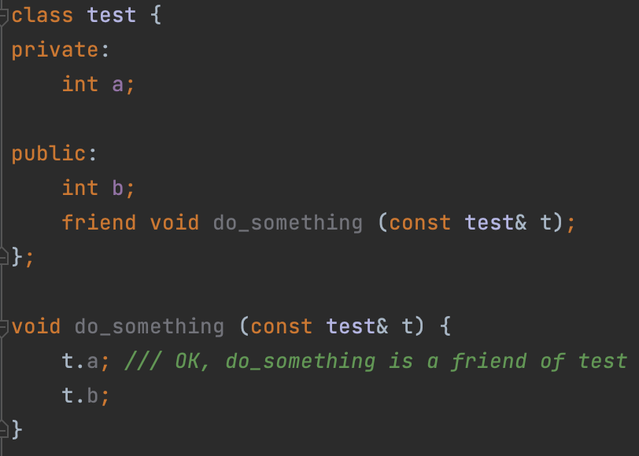
Some anti-patterns
friend keyword: The friend declaration appears in a class body and grants a function or another class access to private and protected members of the class where the friend declaration appears.
You shouldn't use the friend keyword in well-written code, because it goes against the OOP design principle that respects encapsulation (the word friend breaks encapsulation!)

Slide 14
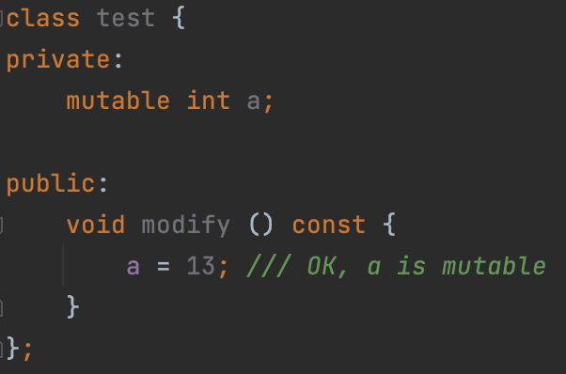
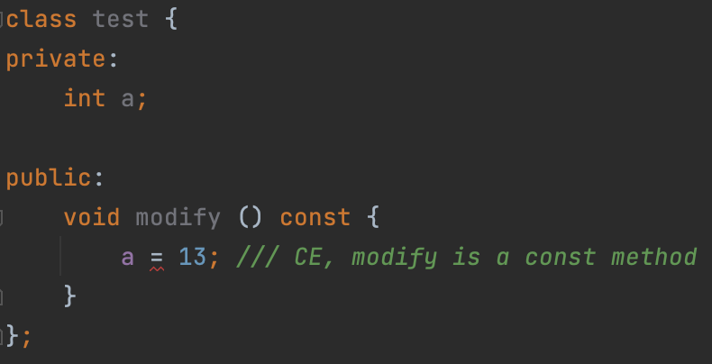
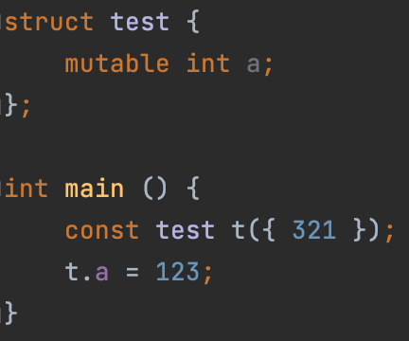
Some anti-patterns
mutable specifier: permits modification of the class member declared mutable even if the containing object is declared const.
Another example:
You shouldn't use the mutable keyword in well-written code, because it goes against the OOP design principle that respects const-correctness (the word friend breaks const-correctness!)

Slide 15
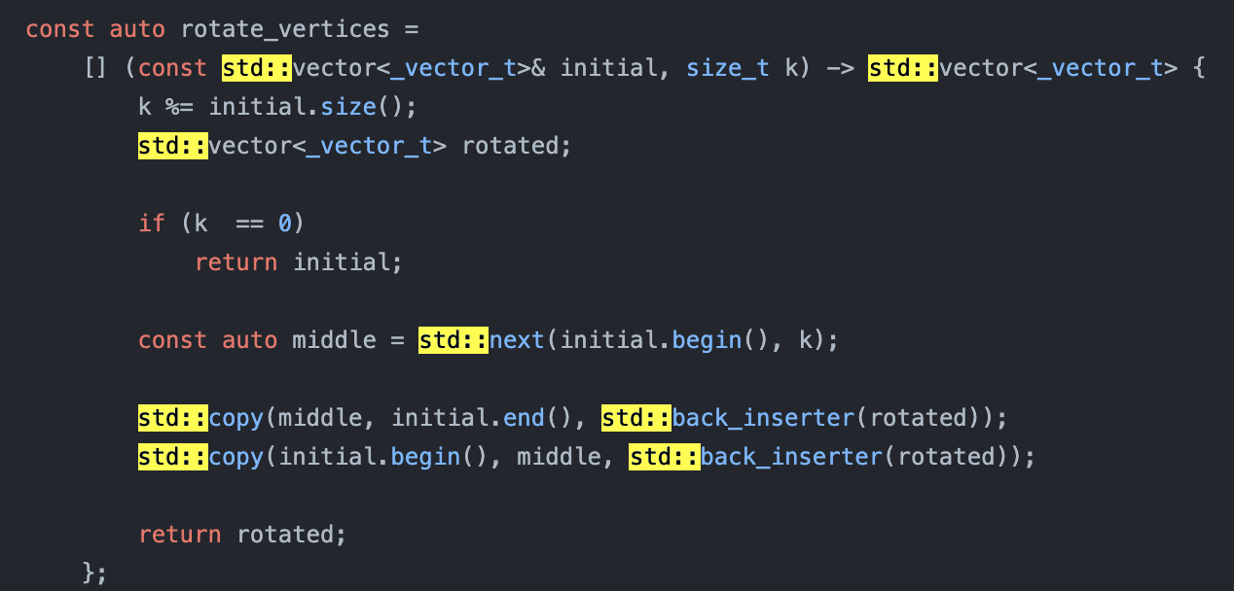
Some anti-patterns
using namespace std
“Problem”: programs often need to use std objects. However, this leads to writing std:: too often. If that doesn't bother you (like me and most of the pros in C++) then it's okay, you can skip this slide. However, if you are worried about writing std:: too often, then you might want to do the following: using namespace std
Let me try to explain why this is bad.

Slide 16
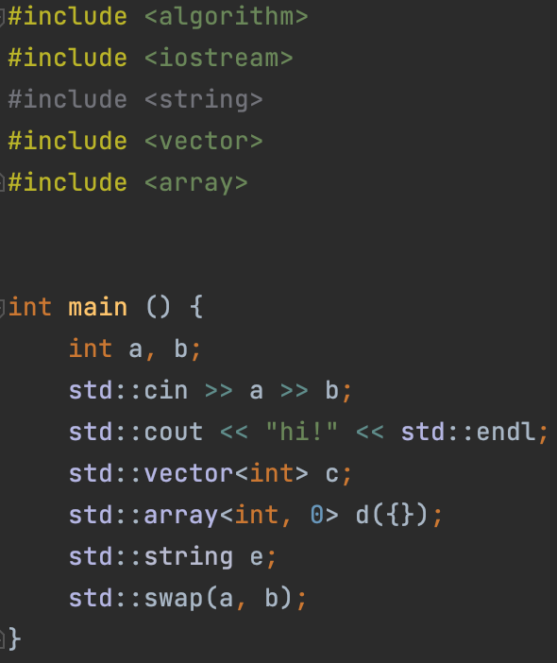
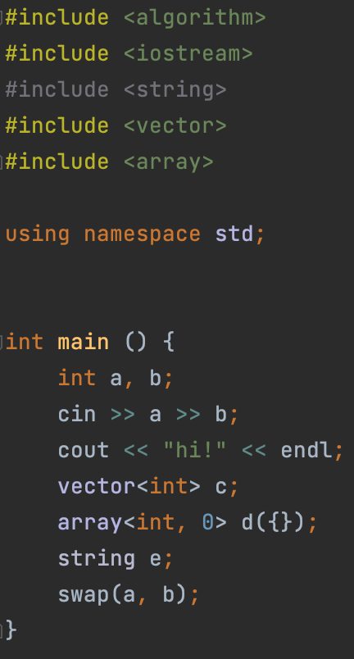
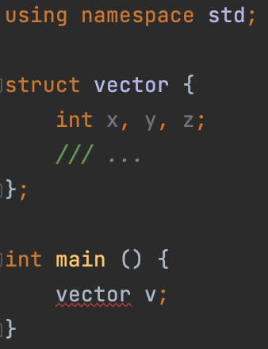
Some anti-patterns
using namespace std
When you do using namespace std, you include absolutely all std objects in your program. As a result, if you unintentionally name some variable or function with the name of an object already existing in std, CE, or, even worse, UB can occur:

Slide 17
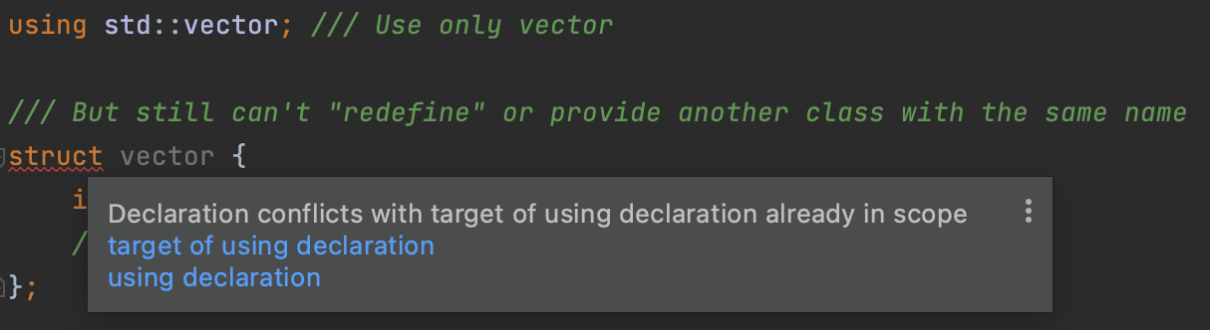
Some anti-patterns
using namespace std
Solutions:
[Approved by me] Use std:: – syntax, and don't worry about often writing it
If, for example, you need to use std::vector often, then do using std::vector;. This will only include the vector in the global namespace, instead of all std–objects (as it was in the case with using namespace std). But again, you cannot define another vector class. That is, even this method has certain limitations, so personally I do not see the point in it.

Slide 18
Namespaces

Slide 19
Lecture 13
Classes and structures, pt.5
Konstantin Leladze
OOP in C++
DIHT MIPT 2021

